Slide 1
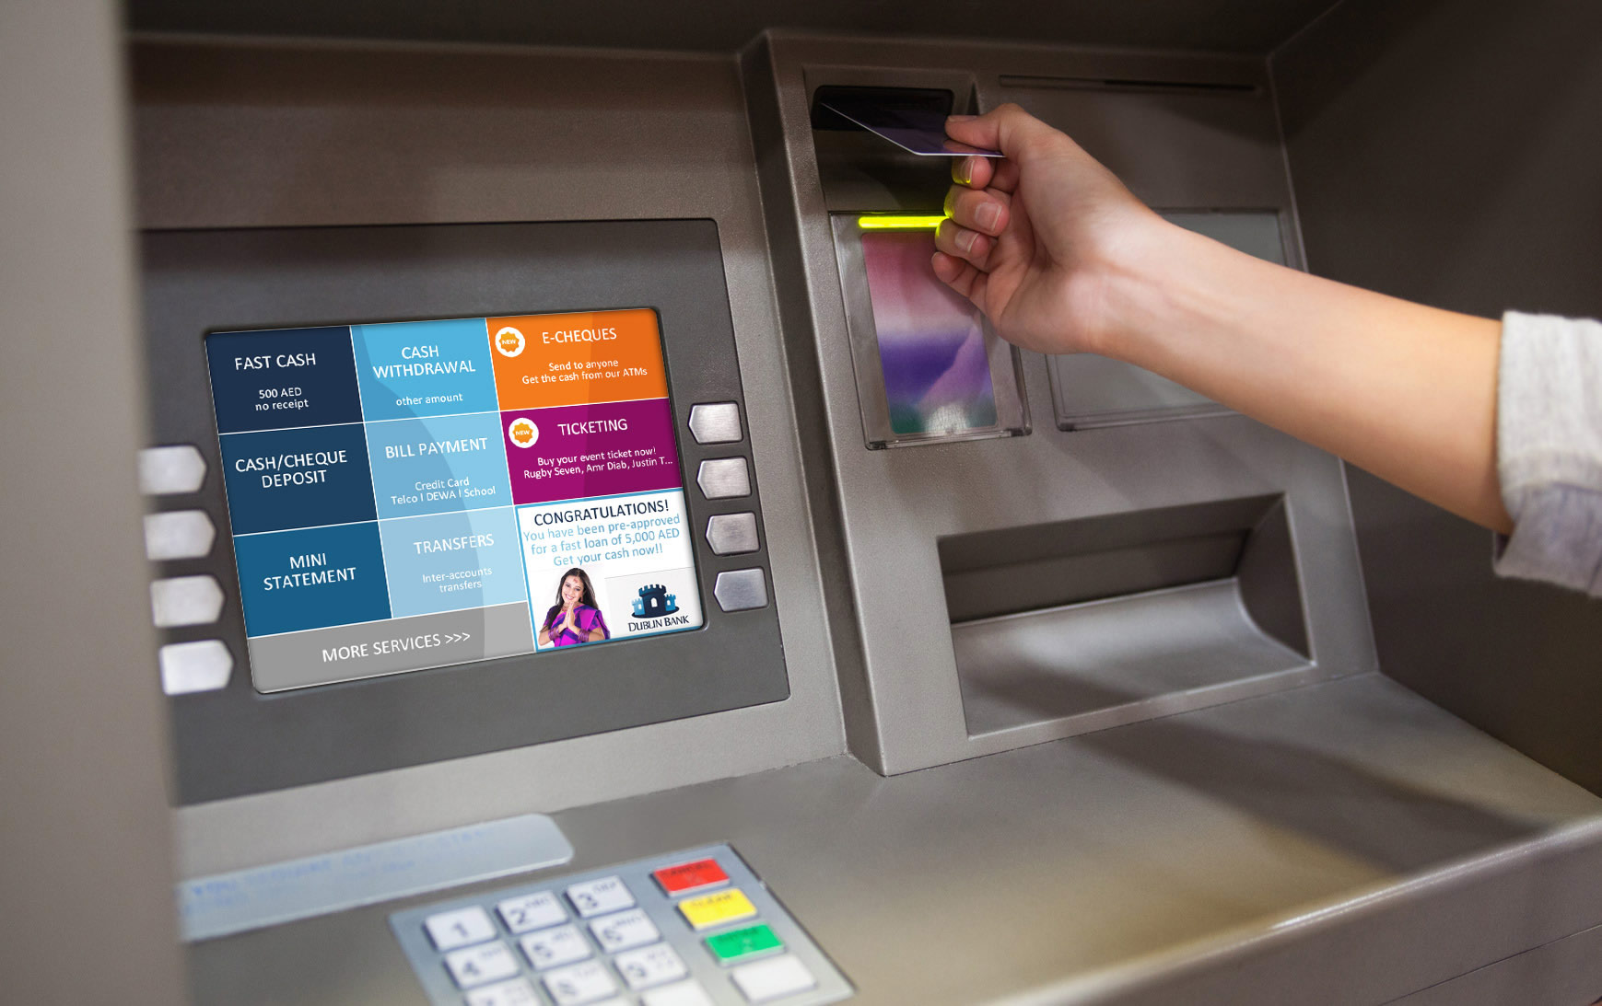
BANK ATM SYSTEM
Designing & Presented by : DSE Group 10

Slide 2
Members of Group
GADSE191F-043 Lakshan I P S
GADSE191F-044 Rubasinghe L M
GADSE191F-048 Kumarasiri O S
GADSE191F-049 Kalhara B G R
GADSE191F-056 Janith Sahasra

Slide 3
Contains
Introduction of the Program
Advantages of the Program
Steps of the Program

Slide 4
INTRODUCTION OF THE PROGRAM
Bank ATM System is the process of any banking methods without bank slips & any other documents
The customer can use an electronic teller card and make easier their work what they want to do.

Slide 5
ADVANTAGES OF THE PROGRAM
Access to bank account from anywhere.
It provides 24h service.
ATM reduce work load of bank staff.
ATM is very beneficial for travelling customers.
ATMs are convenient to bank customers.
Minimized Transaction cost.

Slide 6
STEPS
Customer Interface
Enter Pin Number.
Selecting the Transaction.(Main menu)
1.Deposit Cash
2.Cash Withdrawal
3.Balance Inquiry
4.Bill Payment

Slide 7
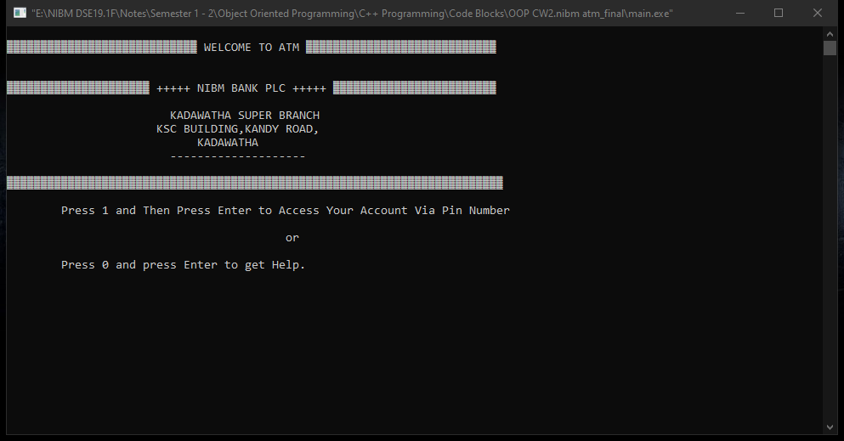
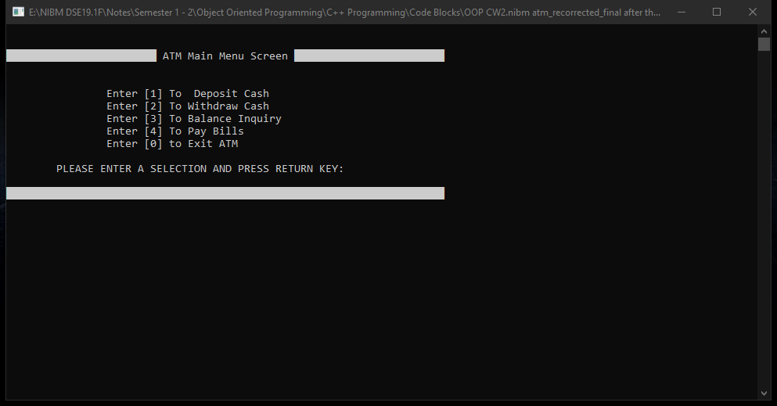
Customer Interface
By the Customer Interface, Customer can get an attraction for the system.
From the customer interface customer can continue the program or get help guideline by press number 1 and 0.

Slide 8
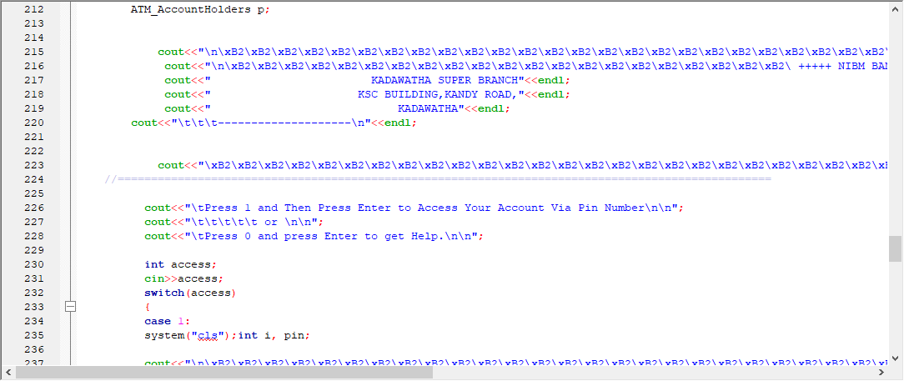
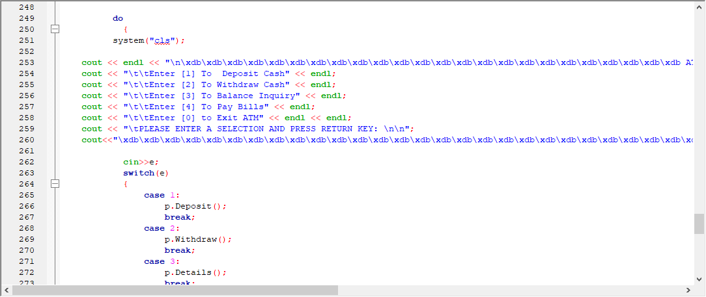

Slide 9
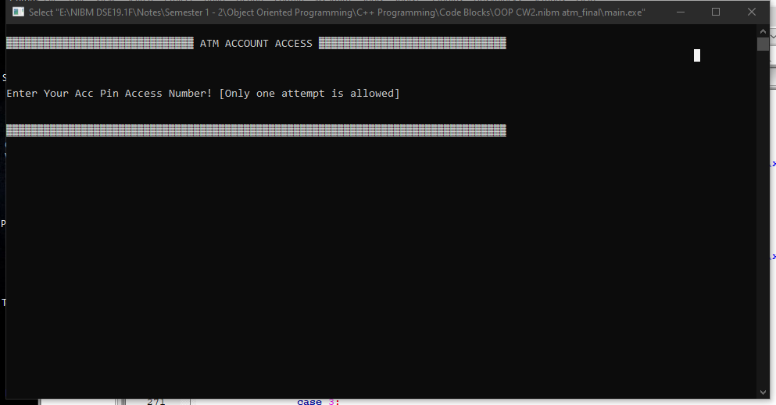
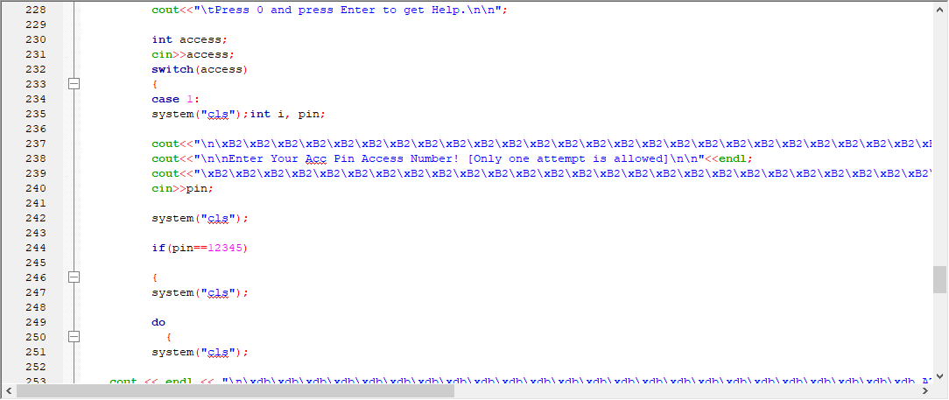
Enter the Pin Number
At the start all the card holder customers have common pin number.
All the customers can change their pin number to their choices.
Customer wants to provide their pin correctly, then the program will be continued.

Slide 10
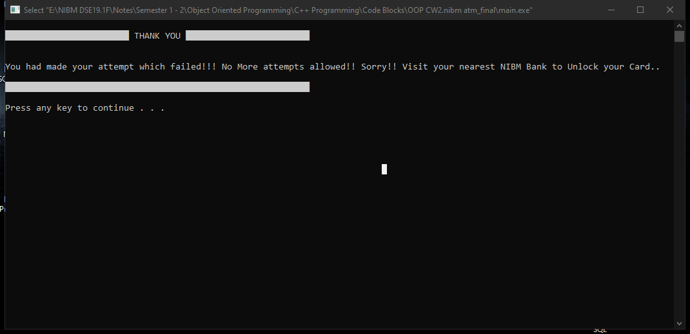
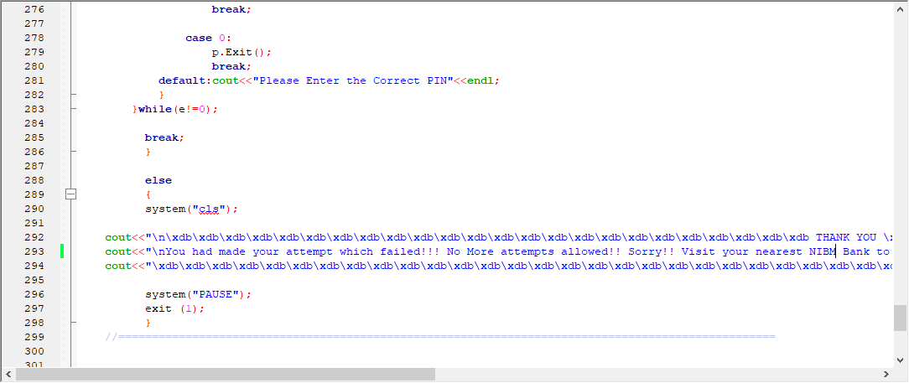
Customer has only one attempt to enter their pin correctly, if the customer entered the pin incorrectly card will be blocked automatically.
And display a message “You had made your attempt which failed!!! No More attempts allowed!! Sorry!! Visit your nearest NIBM Bank to Unlock your Card..”

Slide 11
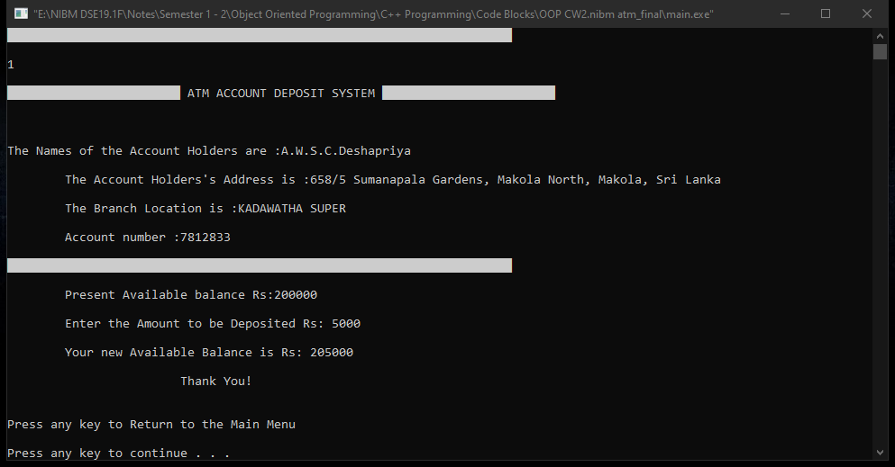
Selecting the transaction 1.CASH DEPOSIT
First transaction method is cash deposit.
The customer can deposit the money according to the customer’s preference.
After the deposit their cash customer can see his balanced amount.

Slide 12
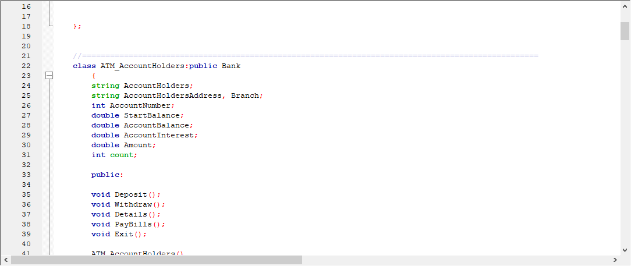
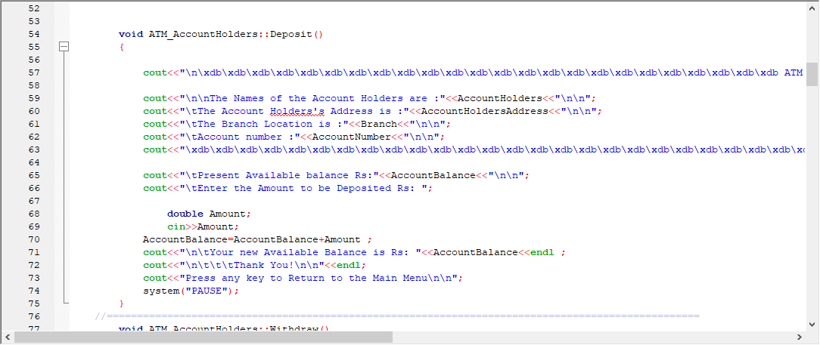
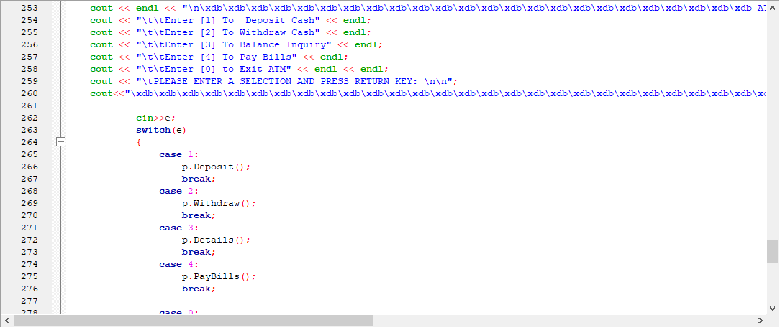

Slide 13
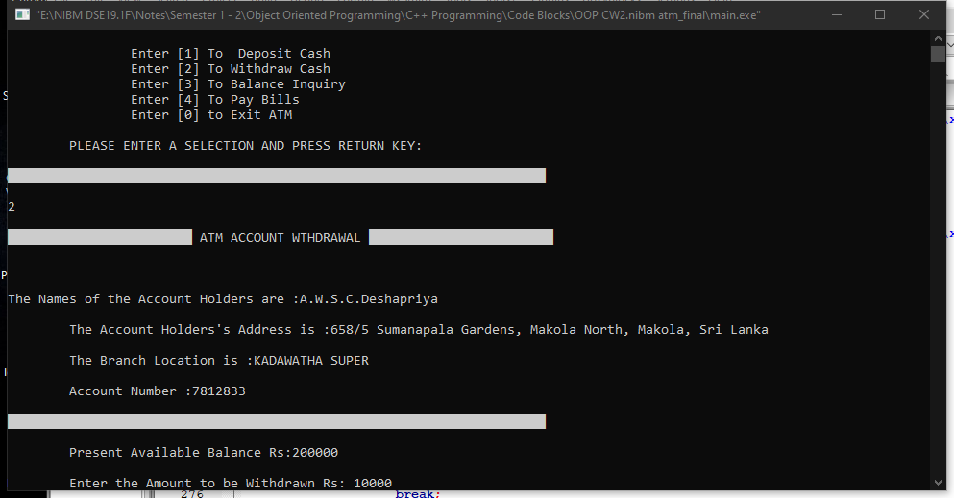
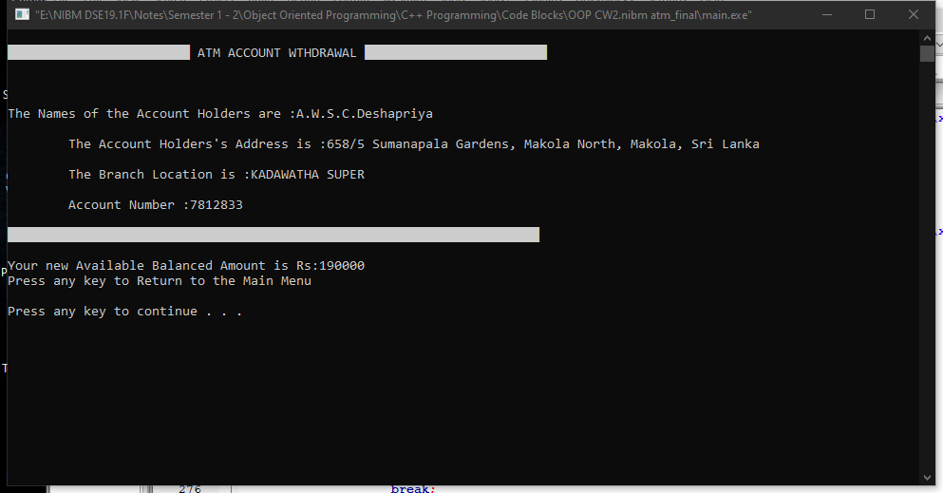
2.WITHDRAW CASH
Second transaction method is cash withdraw.
Customers can withdraw their deposited money from their saving or mobile accounts.
After the withdrawal system gives the balance of the account.

Slide 14
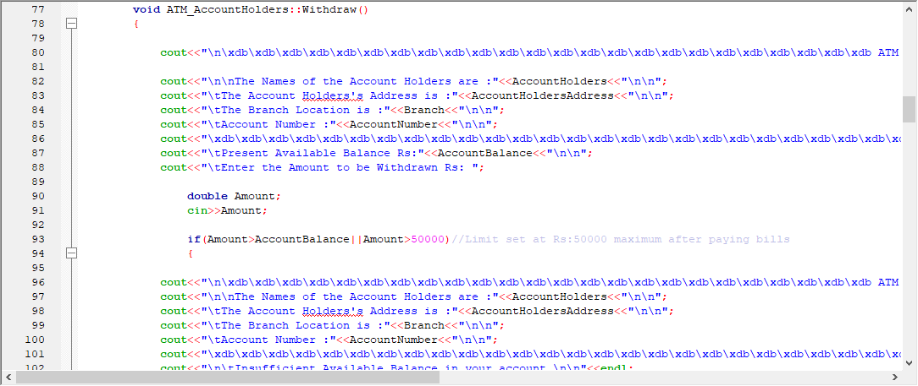
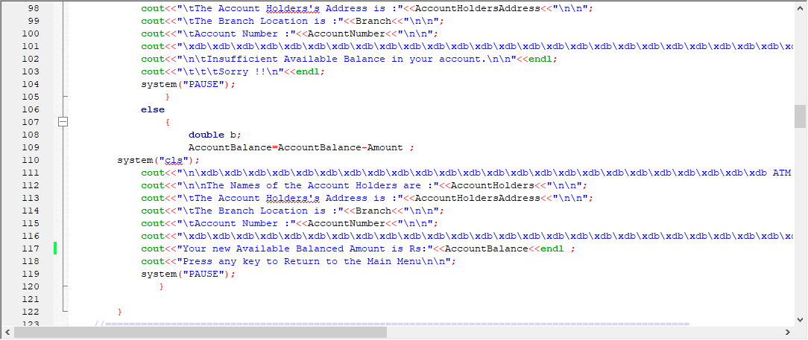
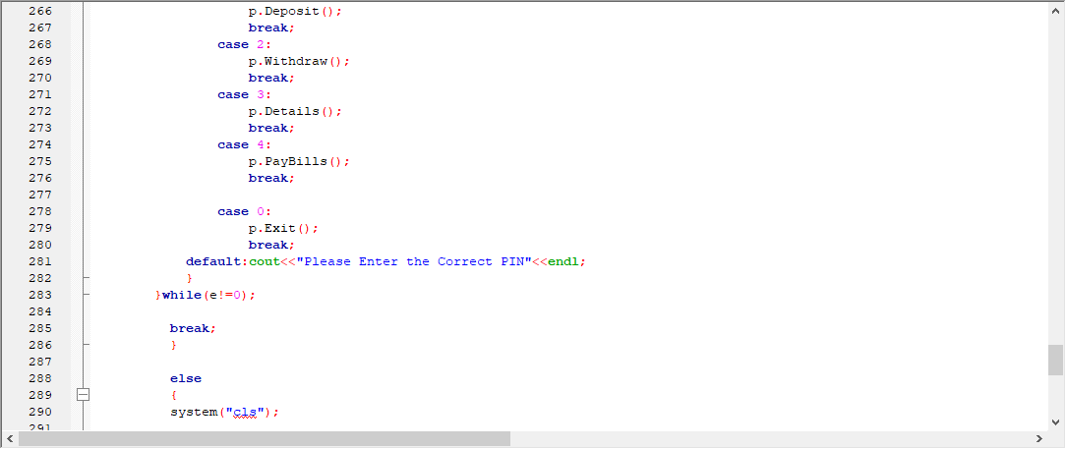

Slide 15
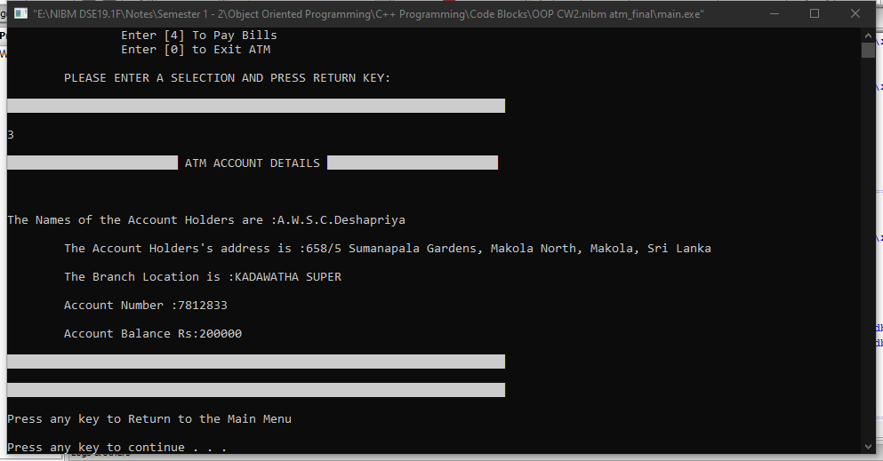
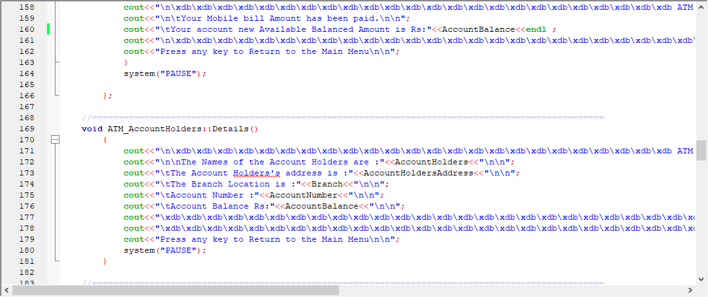
3.BALANCE INQUIRY
Third transaction method is balance inquiry.
After checking the balance, customer can do any other transaction preference to customer’s choice.

Slide 16
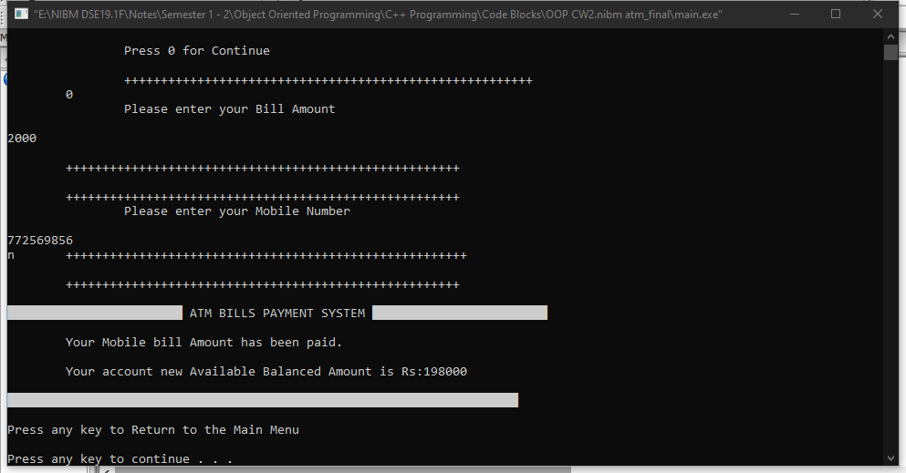
4.BILL PAYMENT
Customer who wants to pay their mobile bill ,they can pay their mobile bill using this system easily.

Slide 17
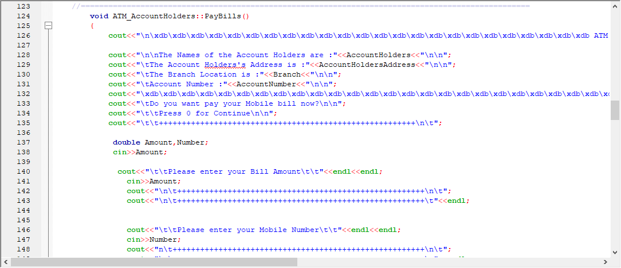
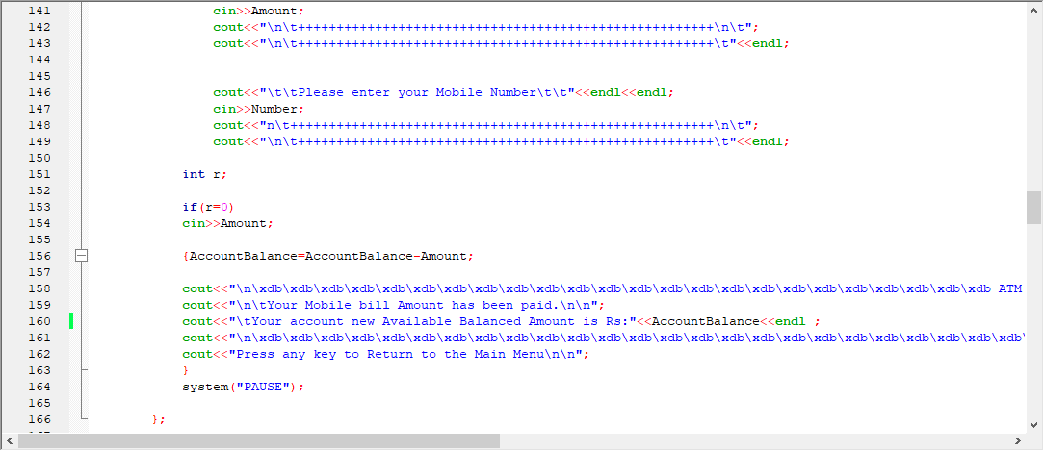
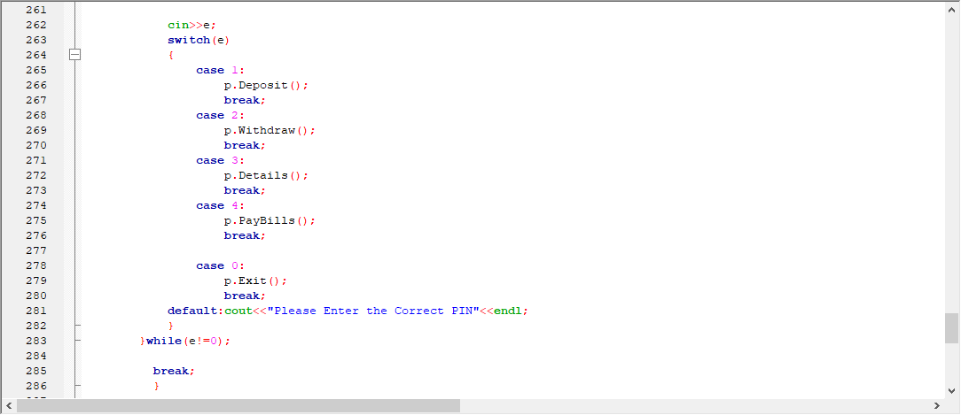

Slide 18
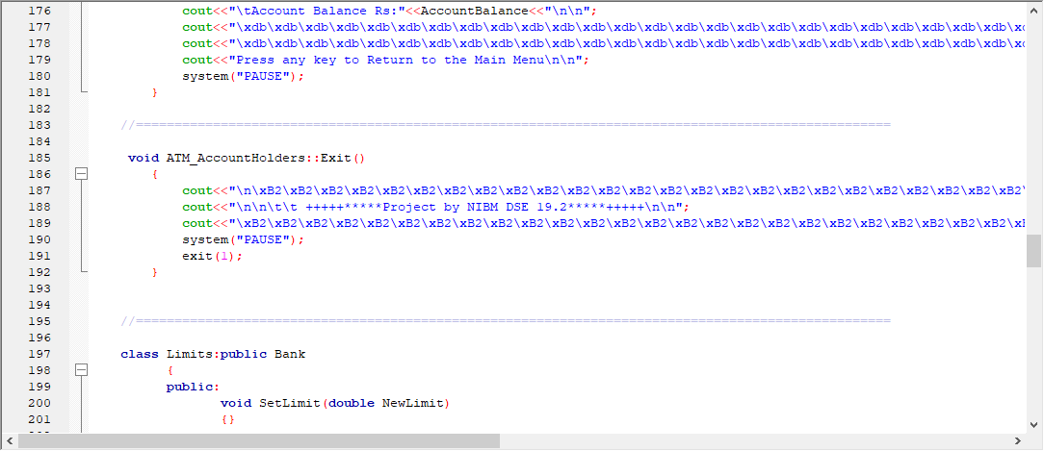
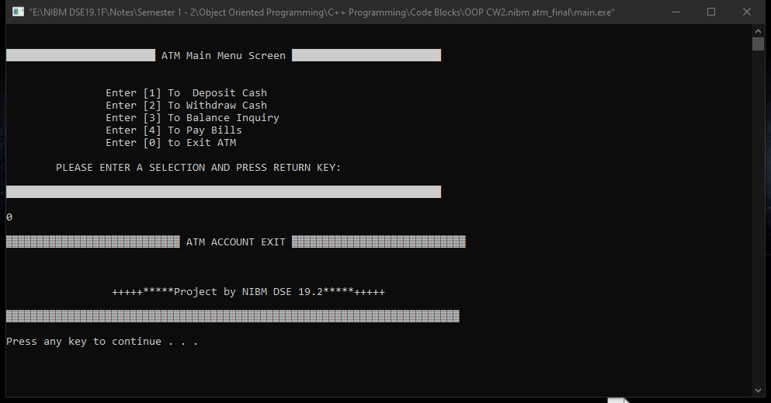
5.EXIT
At the end of the transactions customers can eject their cards by using exit option.

Slide 19
THE END
THANK YOU...!!!

